Slide 1





MALLA REDDY COLLEGE
OF ENGINEERING & TECHNOLOGY
(AUTONOMOUS INSTITUTION - UGC, GOVT. OF INDIA )
FOOD ENERGY
ANUSHA (5N4)
SUSHANT(5N3)
CALORIES
AVINASH(5R0)
BATCH NO : D6
A HEALTHY OUTSIDE STARTS FROM THE INSIDE

Slide 2

ABSTRACT
Food Energy is defined as the energy released from carbohydrates ,fats,proteins and
other organic compounds. When the three major calorigenic nutrients (carbohydrates,
fats and proteins) in a food are burnt entirely with sufficient amounts of oxygen, it
Releases energy or food calories that are expresed in kilojoules(KJ) or kilocalories(kcal).
Energy released by a particular food is a critical parameter in nutrition.Several chronic
Diseases such as obesity,diabetes and cardiovascular disease have been considered to be
caused by excess energy intake. Restricting long-term consumption of high-energy foods
rich in fats and sugar can reduce the incidence of obesity and other diseases. Food energy
is a chemical energy that comes from food & supports metabolism and muscular activity.
The conversion efficiency of energy from respiration into muscular power depends on the
type of food and on the type of physical energy usage. According to the Food and Agriculture Organisations of the United Nations,the average minimum energy requirement per person per day is about 7,500 kJ( 1,800 kcal ).

Slide 3
INTRODUCTION
The "Calculation of Energy from Food" project aims to develop a software solution that accurately determines the energy content of various food items. This software will assist users in tracking their calorie intake and making informed dietary choices. By integrating with a comprehensive food database or API, users can easily access nutritional information for a wide range of foods.
The user interface will be designed to be intuitive and user-friendly, catering to individuals of all technical proficiencies. Performance optimization ensures swift responses and scalability to accommodate growing data and user demands. Security measures will be implemented to protect user data and ensure secure communication with external servers. Compatibility across multiple platforms and devices will enhance accessibility and usability. Thorough documentation and testing procedures will ensure the reliability, functionality, and regulatory compliance of the software

Slide 4
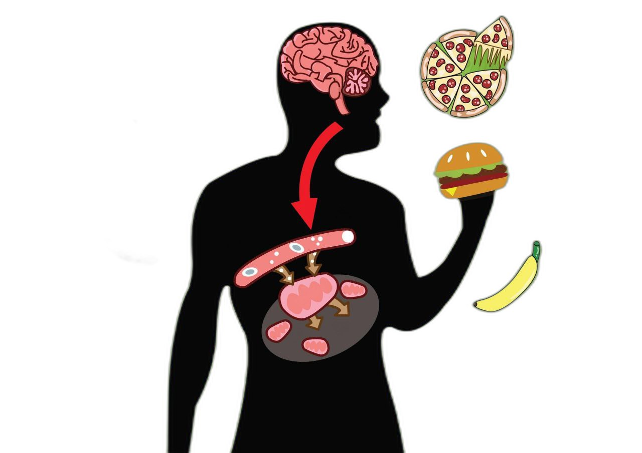
By calculating the energy provided by various foods,individuals can learn to make informed dietary choices,balancing their intake based on their energy needs,which is crucial for managing weight,promoting health and preventing diet- related diseses.
PURPOSE & OBJECTIVES
# 2 Food Science Education
Gain insights into food science,exploring how cooking,preservation, and food processing affect the nutritional quality and energy content of food.
# 1 Health & Diet Awareness

Slide 5
SCOPE OF PROJECT
Nutritional Science Undestanding the food,including macronutrients and their specific caloric contributions.It
Involves studying how these nutrirnts are metabolized by the body to produce energy
Technology & Informatics
Using technology and software to analyze nutritional data,conduct research and present findings.This could involve nutritional analysis software,databases,or mobile apps that track caloric intake and expenditure.
Sustainability in Food Choices
Evaluating the energy efficiency and environmental impact of food production,aiming to promote sustainable dietary choices that consider both nutritional value and ecological footprint.
Food Waste Reduction
Investigating how understanding the energy content of food can contribute to reducing food waste by promoting more mindful consumption and storage practices.

Slide 6
DIRECT CALORIMETRY
NUTRITIONAL DATABASES
EXISTING AND PROPOSED SYSTEM
FOOD LABELS
ENHANCED DATABASE SYSTEMS WITH AI
PERSONALIZED NUTRITION APPS
PORTABLE CALORIMETRY DEVICES
BLOCKCHAIN FOR TRACEABILITY IN FOOD
ENERGY CALCULATION
INTEGRATION WITH WEARABLE TECHNOLOGY

Slide 7





Hardware Requiements
The requirements can widely depening on the complexity of the task,the volume of data to be processed,and the desired accuracy
Kitchen Scale(Optional)
Nutritional Databases
Computer or Smartphone
Barcode Scanner
Computer with Adequate Pocessing Power

Slide 8
Software Requirements
01
02
Database Software
Progamming Languages
03
04
05
Machine Learning Famework
Mobile Apps & Spreadsheets
Web Browser

Slide 9
SRS
2.1 Product Perspective
2.2 Product Features
2.3 Design & Implementation
constraints
4.1 User Interfaces
4.2 HTTP/HTTPS for web
communication
1. Introduction
2 .Overall Description
3.System Features
4.External Interface
Requirements
5.Non-Functional
Requirements
1.1 Pupose
1.2 Document Conventions
3.1 Food Item Database Access &
Management
3.2 Calorie & Nutritional Information
Calculation
5.1 Performance Requirements
5.2 Security Requirements

Slide 10
High Level
Architecture
Detailed Components
External Integrations
Architecture
Deployment Architecture
Security Measures
Monitoring &
Logging

Slide 11

User Interface
Controller
Food Database
User
Enter calorie intake
Send calorie intake
Calculate energy from food
Sequence Diagram
Retrieve food data
Send calorie intake
Display energy output
User Interface
Controller
Food Database
User

Slide 12

Login
Create Password
Forgot Password
Use-Case Diagram
Enter Food Item
Display Energy
User
System
Save History

Slide 13
Error
No
More Food to process?
Process input
Input
invalid
Calculate Total Energy
End
Start
No
Process Calorie Content
Yes
Yes
Activity Diagram

Slide 14
Food
UserInput
Repetitive Input
+ item
+ calorie
+ Food
+ weightGrams
+ foodList
+ weighList
+ getitem()
+ getcalorie()
+ getfood()
+ getweightperGams()
+ getfoodList()
+ getweighList()
CalorieCalulator
Class Diagram
+ calculateEnergy(proteins,cabohydrates,fats
+ getEnergy()
Database
+ FoodInfo
+ getFoodInfo()

Slide 15
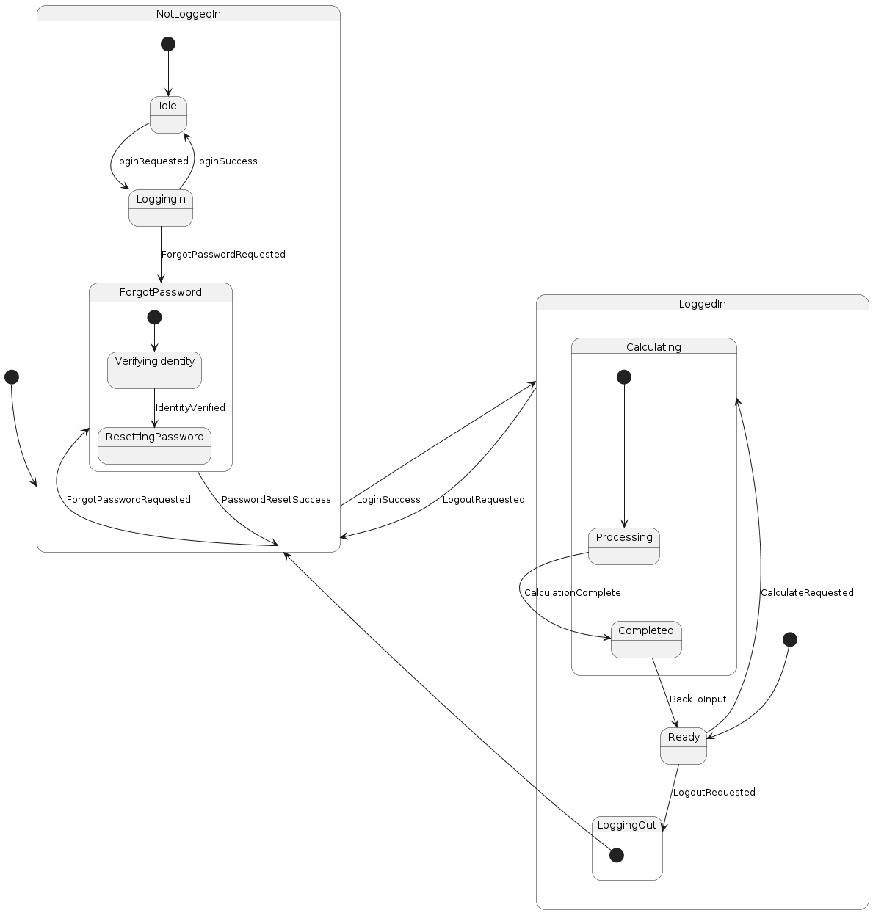
State chart Diagram

Slide 16
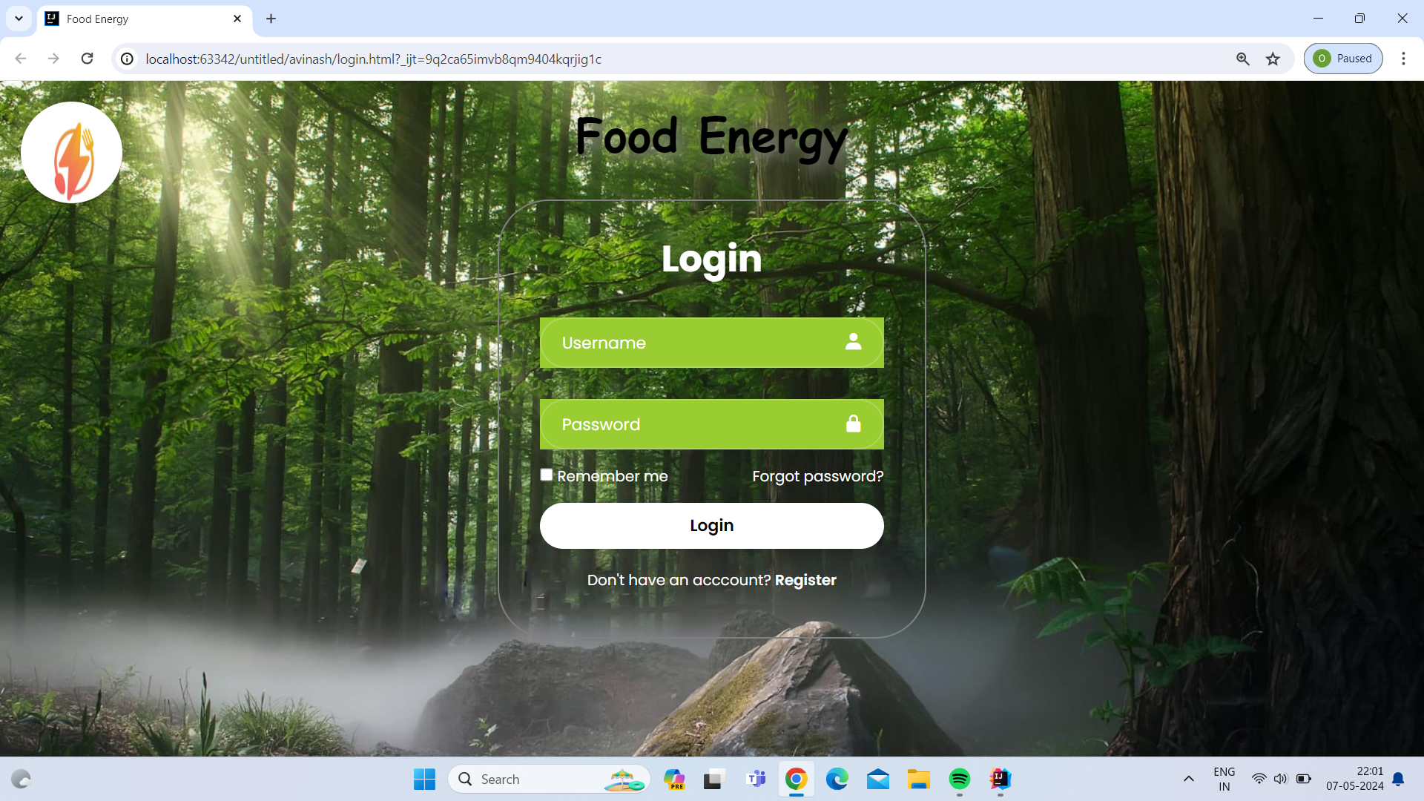
OUTPUT SCREENS

Slide 17
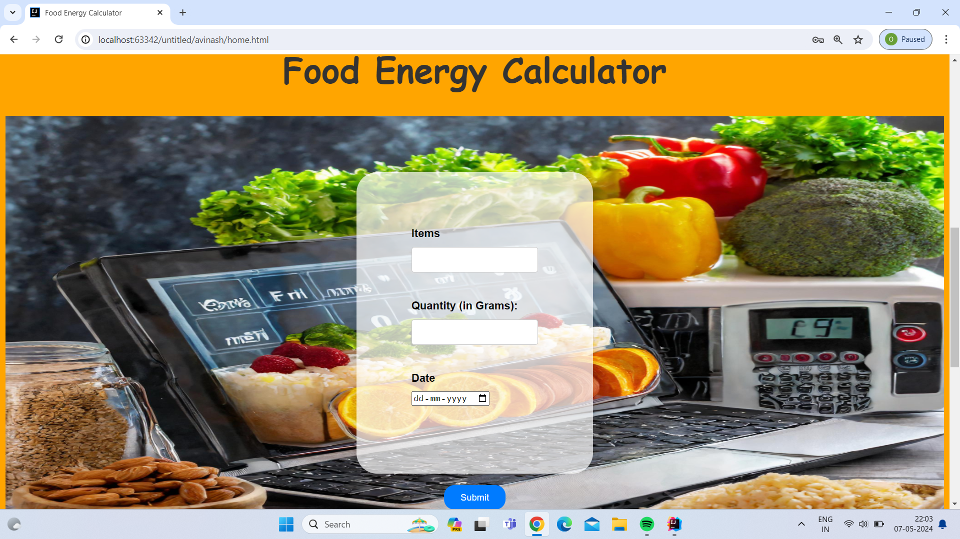

Slide 18
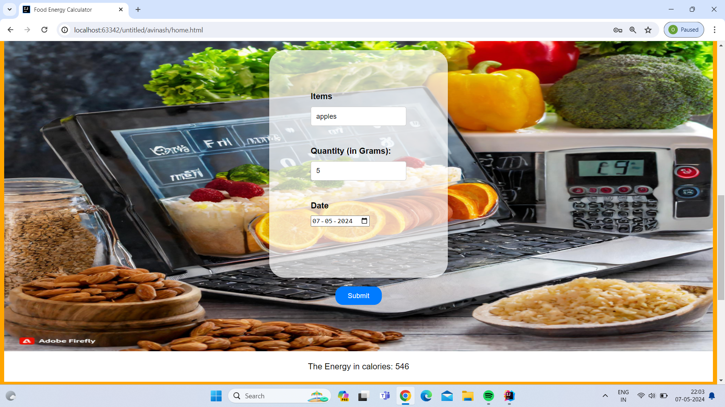

Slide 19

THANK
YOU
NUTRITION ISN’T JUST ABOUT EATING , IT’S ABOUT LEARNING TO LIVE

